Slide 1
MODULE 3
Course Title: Electricity & Magnetism
Course Code: PHYS 102 Unit: 3 CU Lecturer: ABUBAKAR ABDULKADIR

Slide 2
Outline
Biot & Savart Law
Ampere’s law
Magnetic Dipole moment

Slide 3
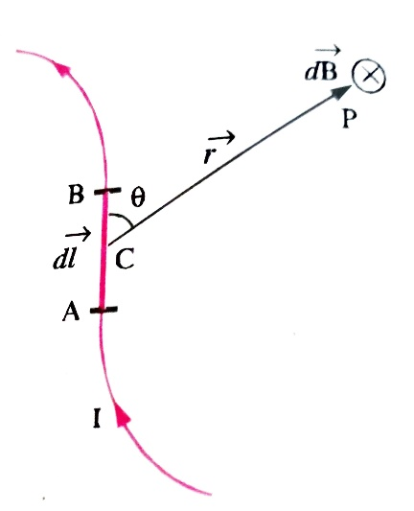
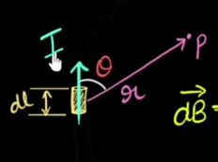
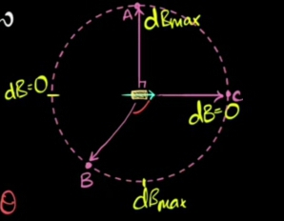

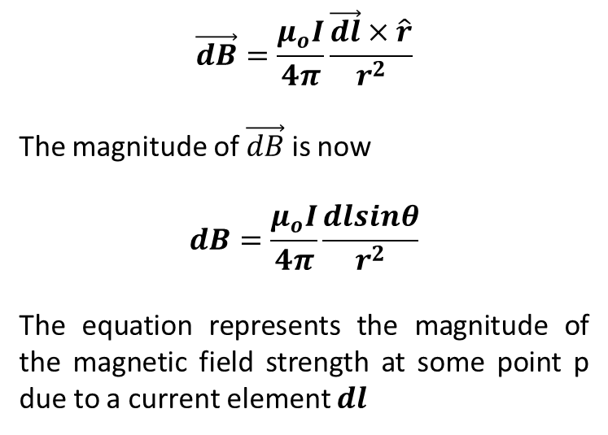
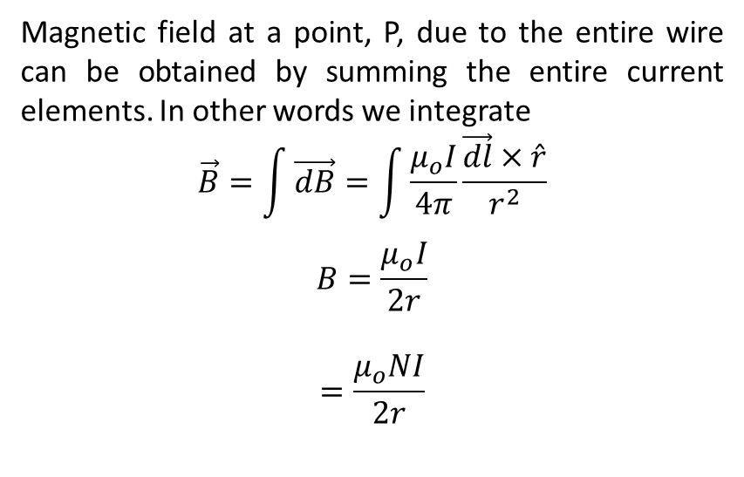
Biot- Savart Law
Magnetic field at a point, P, due to the entire wire can be obtained by summing the entire current elements. In other words we integrate
$$\vec{B}=\int{\vec{dB}}=\int{\frac{μ_{o}I}{4π}}\frac{\vec{dl}×\hat{r}}{r^{2}}$$
$$B=\frac{μ_{o}I}{2r}$$
$$=\frac{μ_{o}NI}{2r}$$
$$\vec{dB}=\frac{μ_{o}I}{4π}\frac{\vec{dl}×\hat{r}}{r^{2}}$$
The magnitude of $\vec{dB}$ is now
$$dB=\frac{μ_{o}I}{4π}\frac{dlsinθ}{r^{2}}$$
The equation represents the magnitude of the magnetic field strength at some point p due to a current element $dl$

Slide 4
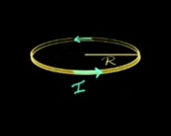
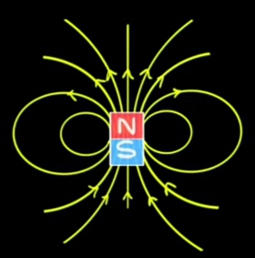
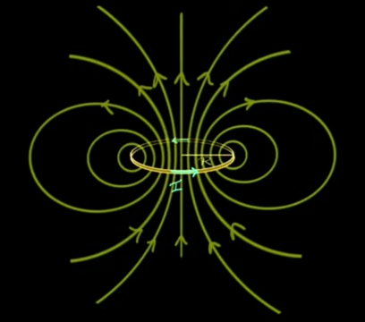
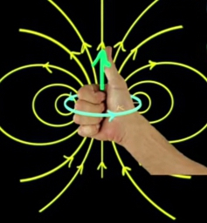
Magnetic Dipole Moment
Concept in Electromagnetism
Definition
A simple definition of the magnetic dipole moment is that… It is a measurement of the strength of the magnetic field that the magnetic dipole generates.
a)
b)
c)
d)

Slide 5
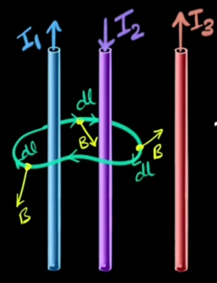

Ampere’s law
Concept in Electromagnetism
Ampere law states that for any closed looped path, the sum of the length elements times the magnetic field in the direction of the length is equal to the permeability times the electric current enclosed in the loop.
$$\oint{\vec{B.}}\vec{dl}=μ_{o}i_{enclosed}$$
Because $\vec{B}$ and $\vec{dl}$ are parallel $(cosθ=1)$ at all points on the amperian loop we can write;
$$μ_{o}i_{enclosed}=B\oint{dl}$$
$$B=\frac{μ_{o}i_{enclosed}}{2πr}$$

